Slide 1
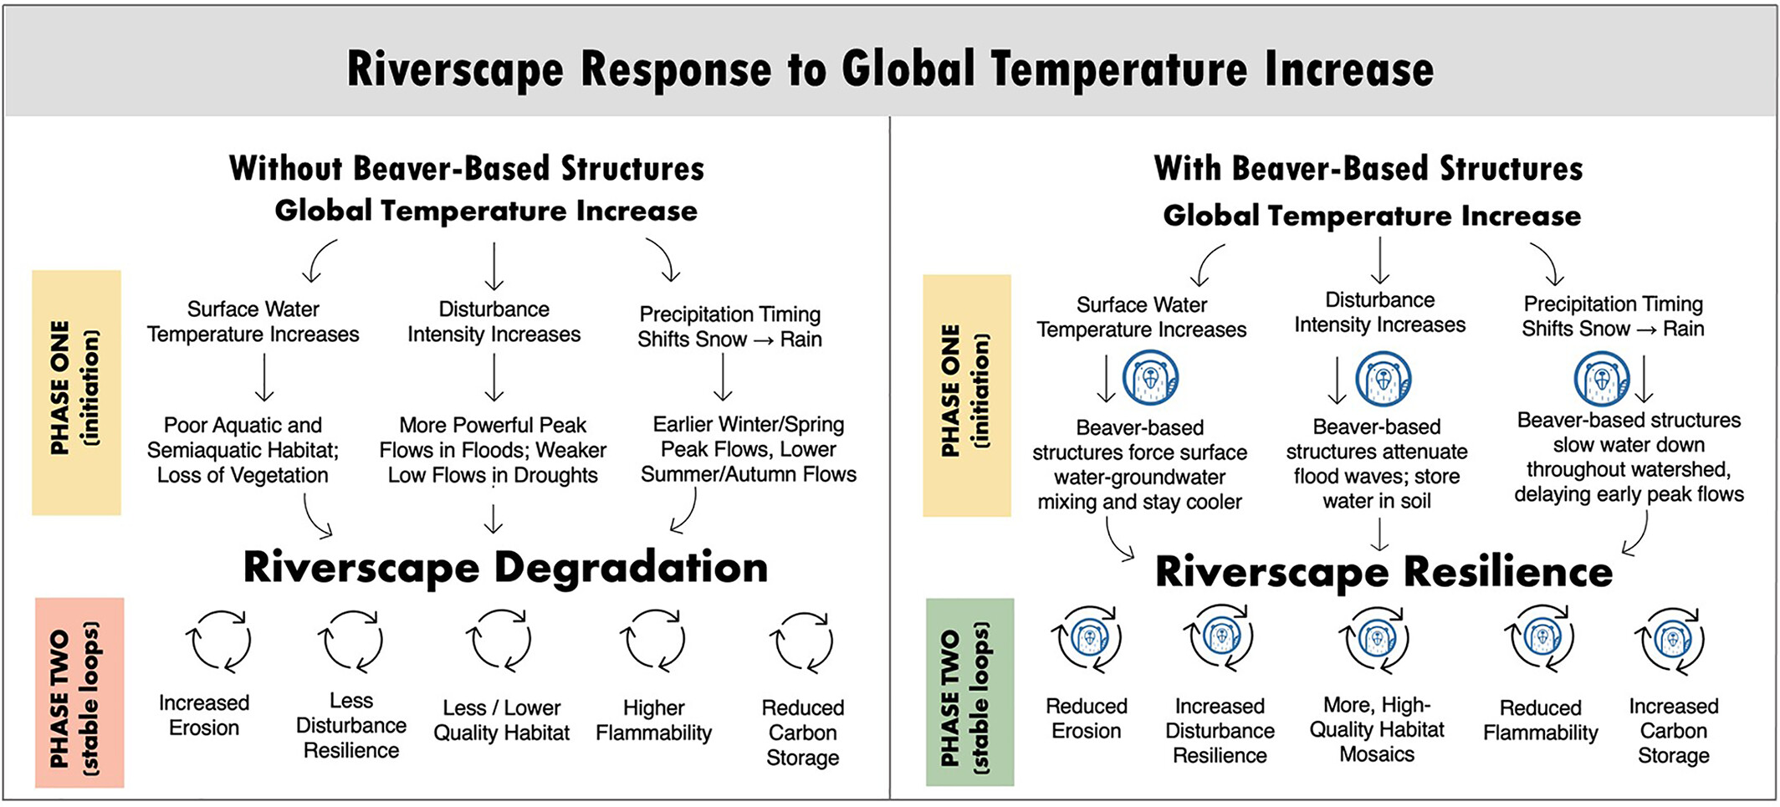
Beaver: The North American freshwater climate action plan
WIREs Water, Volume: 9, Issue: 4, First published: 28 April 2022, DOI: (10.1002/wat2.1592)
Notes:
Comparison of riverscape feedback cycles with increased global temperature. Phase 1 indicates processes that are initiated by warming global temperatures and lead to either degradation or resilience. Phase 2 indicates processes that occur once riverscapes have already reached a degraded or resilient state. Left: Cycle of increasing riverscape degradation occurring without beaver or beaver mimicry. Right: Cycle of maintained riverscape resilience that can be achieved by partnering with beaver and utilizing beaver‐based designs
IF THIS IMAGE HAS BEEN PROVIDED BY OR IS OWNED BY A THIRD PARTY, AS INDICATED IN THE CAPTION LINE, THEN FURTHER PERMISSION MAY BE NEEDED BEFORE ANY FURTHER USE. PLEASE CONTACT WILEY'S PERMISSIONS DEPARTMENT ON PERMISSIONS@WILEY.COM OR USE THE RIGHTSLINK SERVICE BY CLICKING ON THE 'REQUEST PERMISSIONS' LINK ACCOMPANYING THIS ARTICLE. WILEY OR AUTHOR OWNED IMAGES MAY BE USED FOR NON-COMMERCIAL PURPOSES, SUBJECT TO PROPER CITATION OF THE ARTICLE, AUTHOR, AND PUBLISHER.

